Slide 1
DMA (Direct Memory Access)
By Amardeep Limbu

Slide 2
Introduction
a method that allows an input/output (I/O) device to send or receive data directly to or from the main memory, bypassing the CPU to speed up memory operations
The process is managed by a chip known as a DMA controller (DMAC)

Slide 3
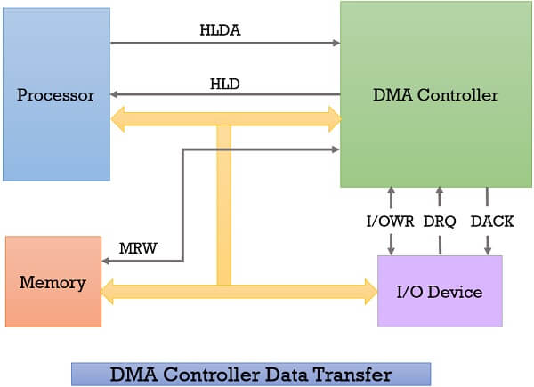
Direct Memory Access Controller & it’s Working

Slide 4
Modes of operation
Burst mode
Cycle stealing mode
Transparent mode

Slide 5
Burst mode
an entire block of data is transferred in one contiguous sequence
the DMA controller is granted access to the system bus by the CPU, it transfers all bytes of data in the data block before releasing control of the system buses back
renders the CPU inactive for relatively long periods of time
also called "Block Transfer Mode".

Slide 6
Cycle stealing mode
the DMA controller forces the CPU to stop its operation and relinquish the control over the bus for a short term to DMA controller
After th
e transfer of every byte, the DMA controller releases the bus

Slide 7
Transparent mode
he DMA controller takes the charge of system bus only if the processor does not require the system bus

Slide 8
Advantage
Transferring the data without the involvement of the processor will speed up the read-write task
DMA reduces the clock cycle requires to read or write a block of data

Slide 9
Refrence
https://binaryterms.com/direct-memory-access-dma.html
https://en.wikipedia.org/wiki/Direct_memory_access
https://www.geeksforgeeks.org/direct-access-media-dma-controller-in-computer-architecture/
https://www.techtarget.com/whatis/definition/Direct-Memory-Access-DMA

